Slide 1
Grainger - End of Tenancy
SteerCo Update
1st November 2023

Slide 2
Project Summary
Milestones
Risks and Issues
Forecast and Budget
Next Steps

Slide 3
Project Summary
The project is currently in the delivery phase, we are midway through the 3rd of 4 sprints
Sprint 4 is will be completed on 1st December.
The go-live date is currently planned for January 2024.
September 2023 October 2023 November 2023 December 2023 Jan 2024
Sprint 1
UAT
Sprint 2
UAT
Sprint 3
UAT
We are here
Sprint 4
UAT
December break
Go Live

Slide 4
Project Summary
The project is currently in the delivery phase, we are midway through the 3rd of 4 sprints
Sprint 4 is will be completed on 1st December.
The go-live date is currently planned for January 2024.
September 2023 October 2023 November 2023 December 2023 Jan 2024
Sprint 1
UAT
Sprint 2
UAT
Sprint 3
UAT
Sprint 4
UAT
December break
Go Live

Slide 5






Project Summary... continued
We have been following an agile methodology with 2 standups and 1 refinement session per week. Grainger stakeholders have been highly responsive, and the project team as a whole is working very well together.
Open Box Delivery Team
GRAINGER Delivery Team
4
Salesforce Architect
- Sam
Business Analyst
- Nikki
Developers
- Matthew, Dillan, Anjali, Avi, Sachin
Quality Assurance
- Khonani
Project Manager
- Shaun
Product Owner
- Jacob
Sprints
Project Sponsor
- Jon
10
Project Manager
- Yvonne
Additional User Stories
1
Subject Matter Experts
- Anita, Mike
UAT Bugs Logged

Slide 6
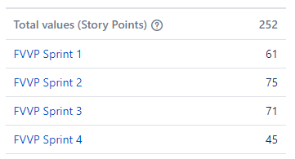
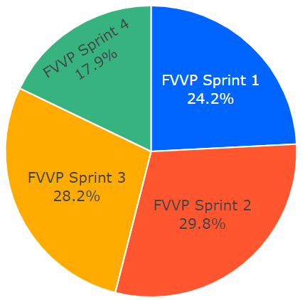
Milestones
Sprint 1 was delivered to UAT on 2nd October (12 stories)
UAT feedback from Sprint 1:
  2 stories were included in Sprint 2; 6 stories will be included in Sprint 3
  1 story is awaiting confirmation of final requirements from Grainger.
Sprint 2 was delivered to UAT on 23rd October (20 stories)
Sprint 3 scope: 28 stories are signed off, 4 stories still require refinement of Acceptance Criteria
Sprint 4 scope: 1 story is signed off; 7 stories require Grainger input &/or requires refinement of Acceptance Criteria
Story Points per Sprint
Sprint 1 Burn Down

Slide 7
Milestones… continued
Project Objectives per the Statement of Work | Status
Enable users to create & complete an end-to-end void workflow | Completed
Automatically calculate & revise estimated void timelines | Completed
Enable users to upload void-related documents to Salesforce | Completed
Audit history | Completed
Automatically update Salesforce units with void-related information | In Progress
Provide a view of voids for a unit & building | In Progress
Replace internal notification emails with tasks & dashboards | In Progress
Provide a view of task lists for users and teams | Refined
Display a property calendar of onsite void tasks | Refined
Display a dashboard of KPIs & voids behind schedule | Partially Refined

Slide 8
Risks & Issues
Risk | Impact | Probability | Mitigation
No change management plan | High | Medium | Open Box working with Grainger to assess options.
No support agreement in place | Low | Low | Open Box to work with Grainger to assess what options are feasible.
Issue | Impact | Status
None | NA | NA

Slide 9
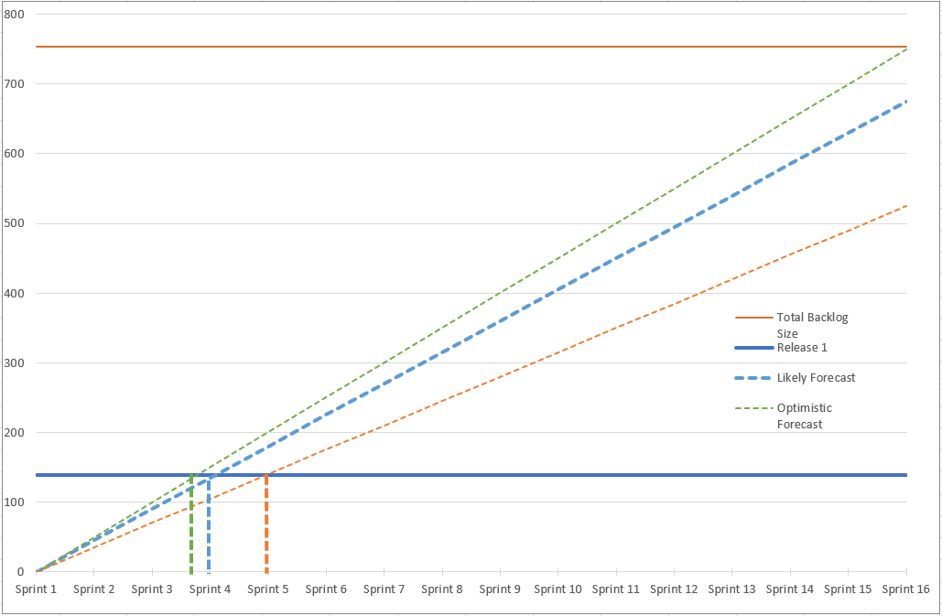
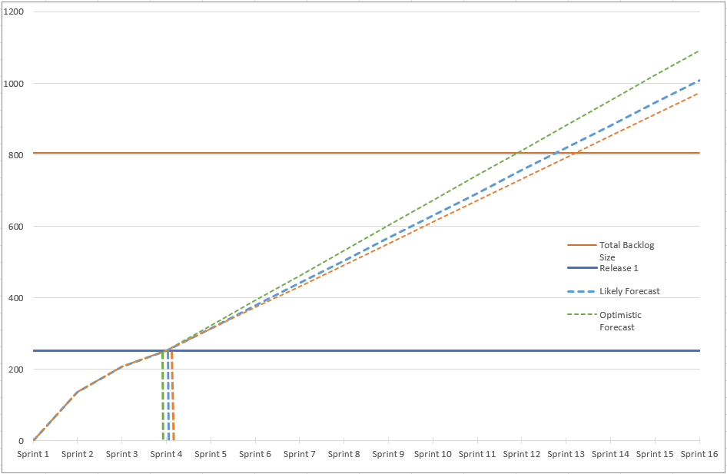
Forecast
Pre-delivery
Current View
754
806
Backlog
Backlog
185
251
Story Points
Story Points
4 - 5
4
Sprints
Sprints

Slide 10


Budget
The project is currently on budget. We anticipate closing out the project without any additional costs
The billing milestones are as follows:
  £ 35,100 was billed on 1st Oct
  £ 35,100 to be billed 1st Nov
  £ 70,200 to be billed 1st Dec
  £ 3,600 to be billed 1st Jan
  £ 3,600 to be billed 1st Feb
We will continue to monitor and manage project costs closely.
Billing
Billing per Sprint
£147,600
1 of 4
Sprints invoiced

Slide 11
Next Steps
Sprint 3 & Sprint 4 to be completed
Open Box to assist Grainger to plan for change management
Schedule the final end-to-end UAT with testers
Plan go-live dates and cutover actions
Planning for release 2 / FTE support

Slide 12
Thank You

